Slide 1
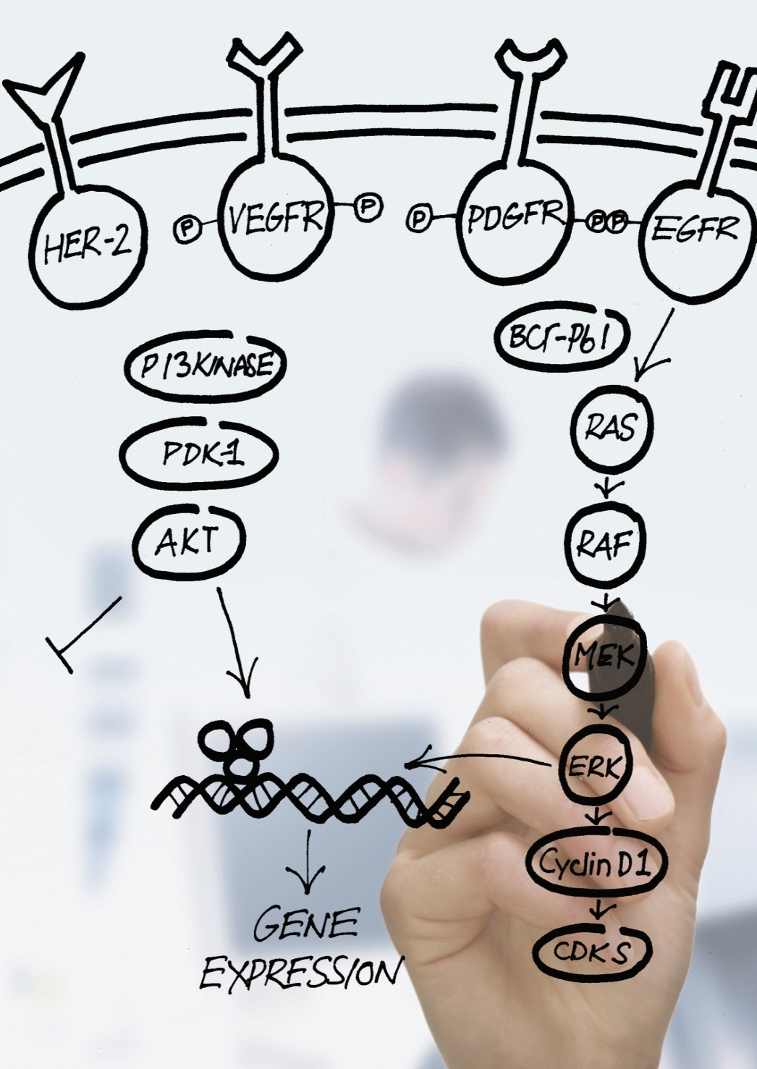
Detection of BRCA1/2 Mutations by Sequencing in BRCA Mutation-associated Breast and Ovarian Cancers
Sponsor:
Service Provider: QIAGEN (Suzhou) Translational Medicine Co., Ltd
Bringing Biomarkers and CDx
to Personalized Medicine
1

Slide 2
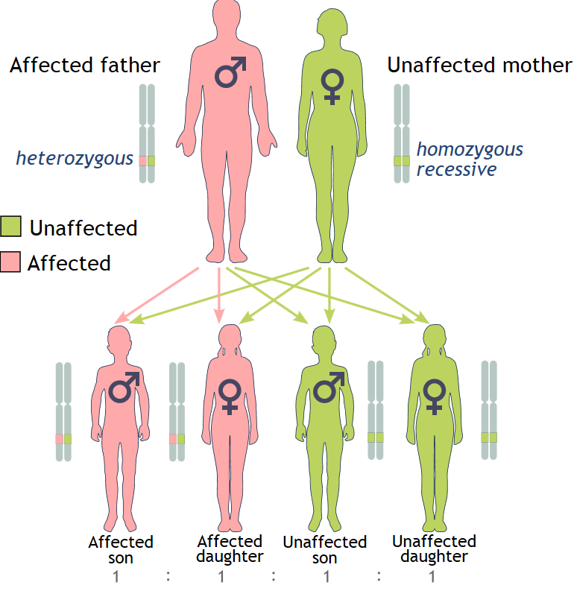

BRCA1 and BRCA2 and Mutations
BRCA1/2 genes are tumor suppressor genes that orchestrate a variety of cellular processes to protect the genome from accumulating damage that is a hallmark of malignant transformation. The best-understood role of the BRCA1/2 genes is in the repair of double-strand breaks (DSBs) in DNA.
The cancer risk caused by BRCA1 and BRCA2 mutations are inherited in a dominant fashion even though usually only one mutated allele is directly inherited.
BRCA mutations are inherited in a genetically dominant fashion, from either parent.

Slide 3
BRCA1 and BRCA2 and Mutations
There are many variations in BRCA genes, and not all changes confer the same risks. Variants are classified as follows:
Deleterious mutation
Suspected deleterious
Variant of unknown significance (VUS)
Variant, favor polymorphism
Benign polymorphism

Slide 4
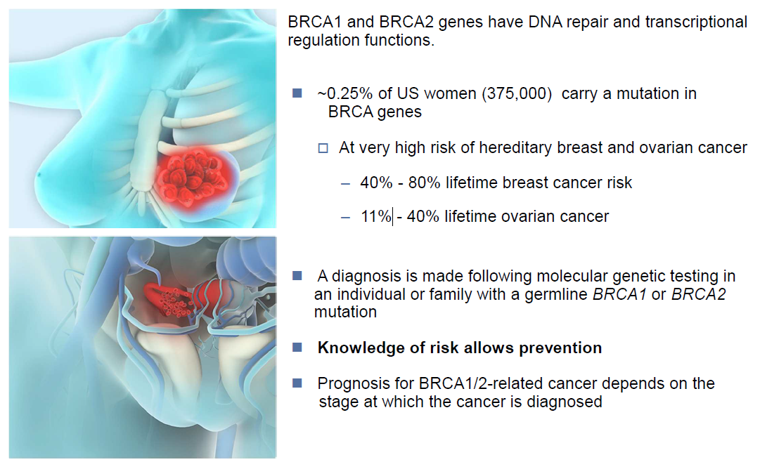
BRCA1 and BRCA2 Are Key Tumor Suppressors

Slide 5
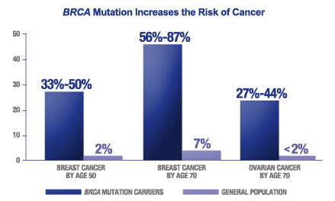
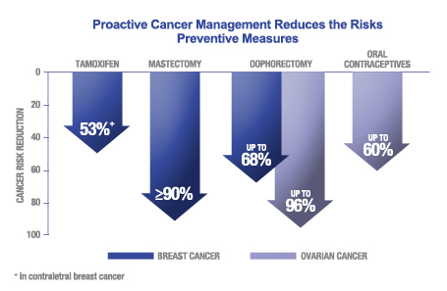
Why Take a Breast/Ovarian Cancer Risk Assessment Test?
Hereditary Breast and Ovarian Cancer (HBOC) Syndrome:
Causes about 10% of breast and ovarian cancer.
Substantially increases your risk for developing breast and ovarian cancer, often before the age of 50 (see chart).
Is most often due to a mutation, or alteration, in either of 2 genes: BRCA1 and BRCA2.
Can be inherited from either your father or your mother.
Can be passed on to your children if you have it.

Slide 6
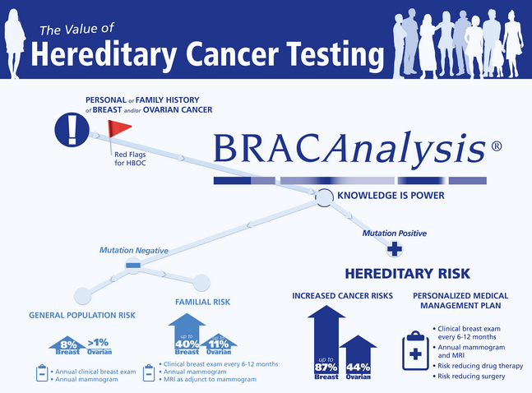
BRCAAnalysis
Myriad Genetics:
The association between breast cancer risk and BRCA1/2 mutations fueled a race to develop a means to identify mutation carriers at increased risk of breast and ovarian cancer. The victor was Myriad Genetics, a Utah-based company that subsequently patented the genes and began to offer commercial sequencing tests.

Slide 7
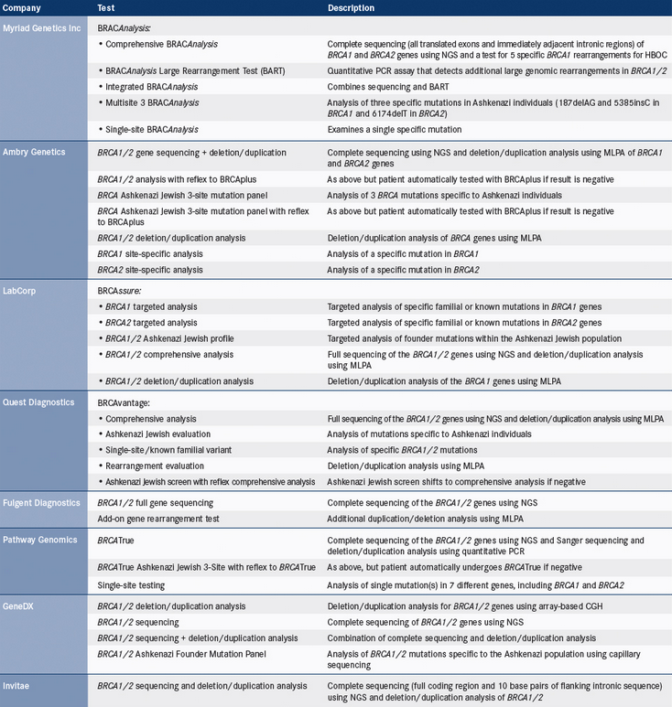
Stand-alone Commercial BRCA Tests

Slide 8
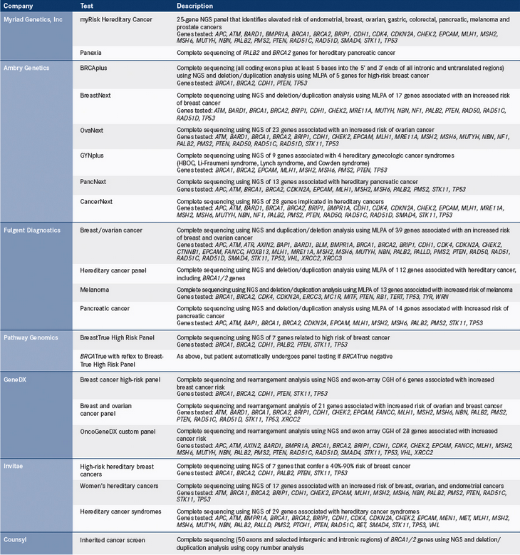
Commercial Sequencing Panels That Include BRCA Genes

Slide 9
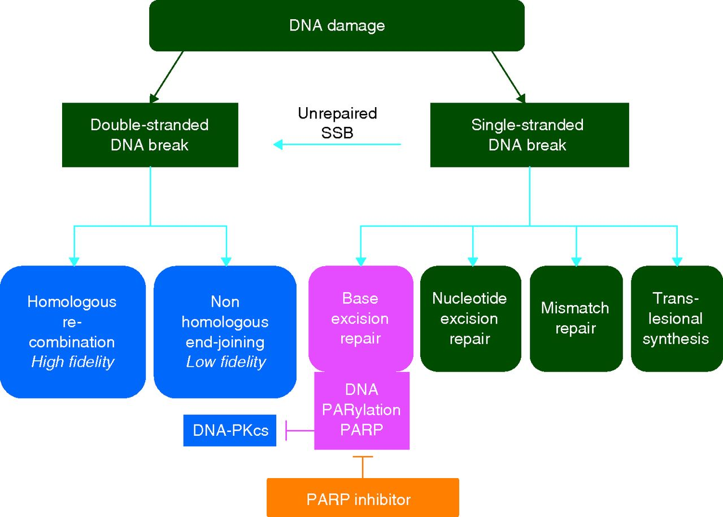
PARP Inhibitor Shows Specificity for BRCA Tumors
Double-strand break repair and single-strand break repair with poly(ADP-ribose)polymerase inhibitors (PARPis)
Lee J et al. Ann Oncol 2013;annonc.mdt384
Published by Oxford University Press on behalf of the European Society for Medical Oncology 2013. This work is written by US Government employees and is in the public domain in the US.

Slide 10
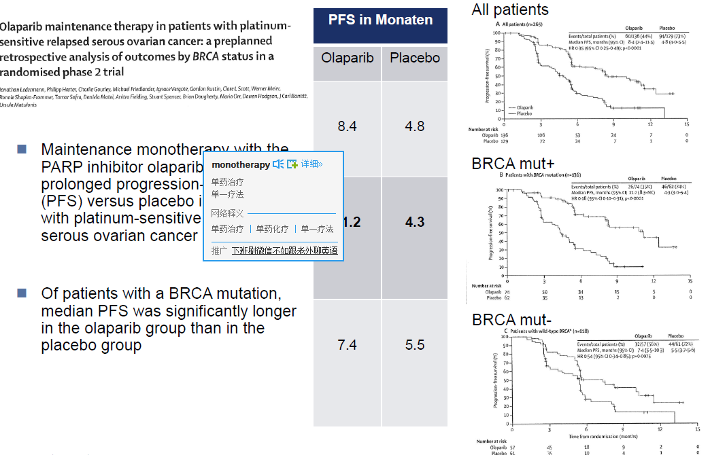
BRCA1 and BRCA2: New Development

Slide 11
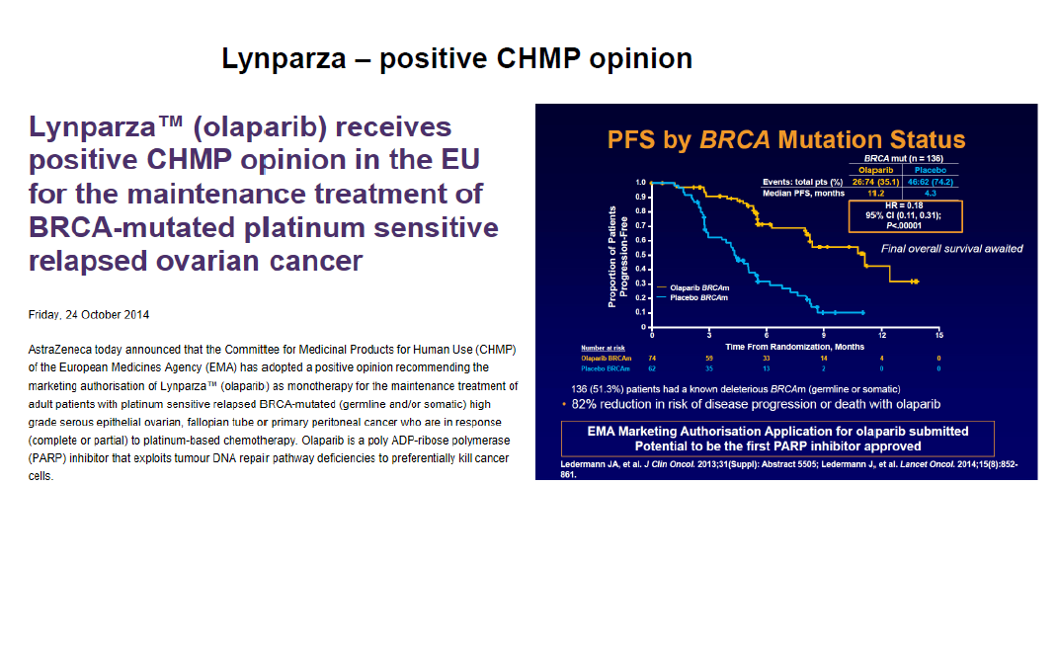
BRCA1 and BRCA2: New Development

Slide 12
Biomarker portfolio
Biomarker: BRCA1/2
Drug target
Biomarker
BRCA1/2
Analyte
Mutations
Detection assay
Sequencing
PARP
Material needed
Frozen or FFPE tissue, cell line
Platform
Illumina sequencer
References
1. Jane de Lartigue. The New BRCA1/2 Landscape. [Published on line Saturday, December 13, 2014 ]. Onclive. 2014.
Kit/antibody etc
Ion PGM sequencer/Proton

Slide 13
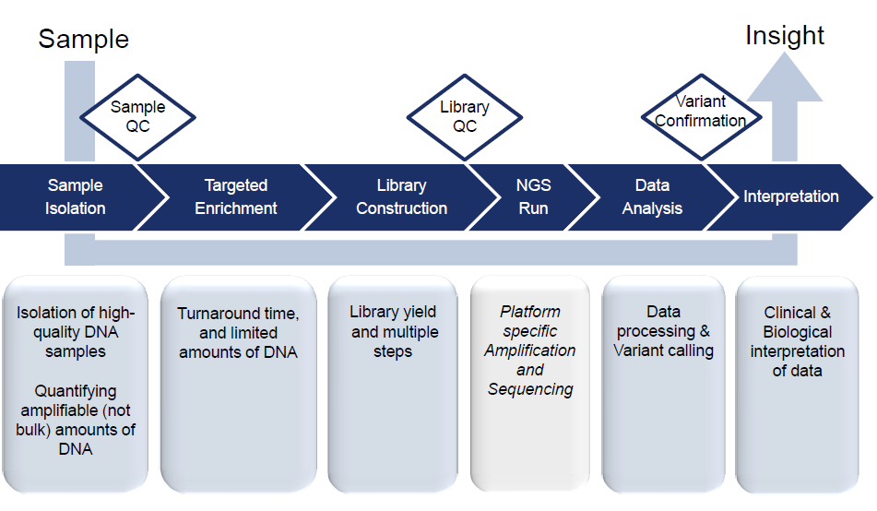
Qiagen GeneRead DNAseq Gene Panels
Genomic DNA isolation
Targeted enrichment by GeneRead DNAseq Gene Panels
Library construction
NGS and data analysis with QIAGEN NGS Data Analysis Web Portal

Slide 14
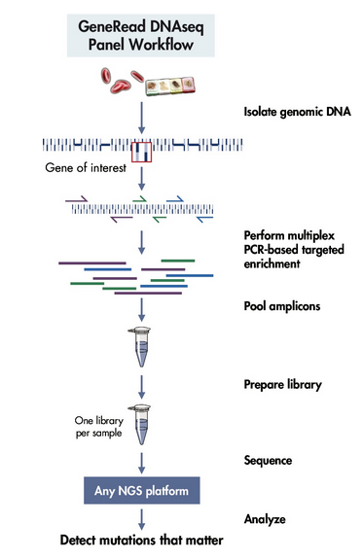
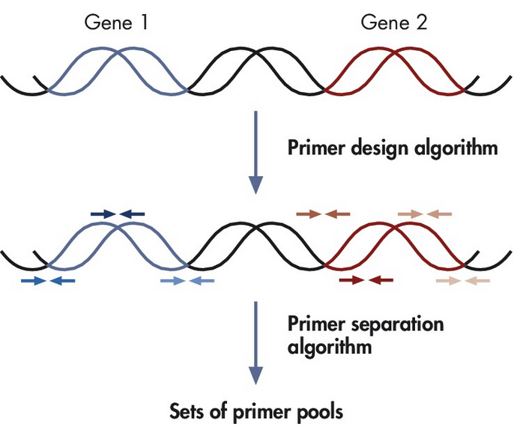
GeneRead DNAseq Panel Workflow
The sequencing results can be analyzed using the GeneRead DNAseq Analysis Software at:
http://ngsdataanalysis.sabiosciences.com

Slide 15
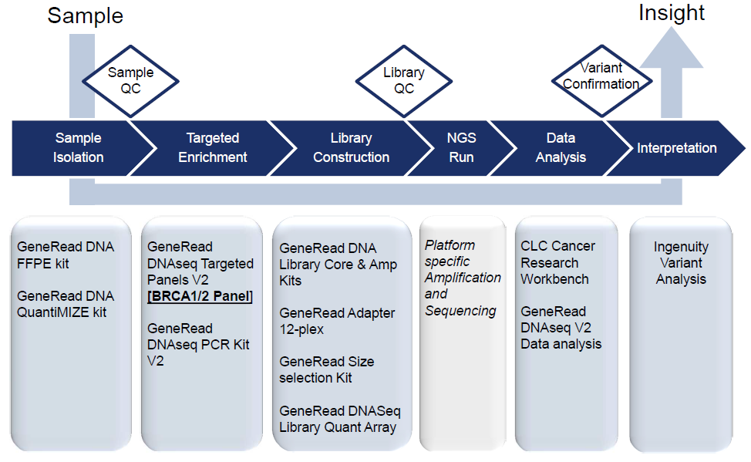
GeneRead DNAseq Panel Workflow

Slide 16
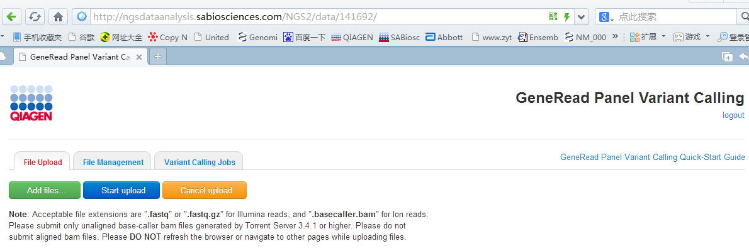
GeneRead DNAseq Panel
Data Analysis Software
The sequencing results can be analyzed using the GeneRead DNAseq Analysis Software at http://ngsdataanalysis.sabiosciences.com, which will automatically perform all steps necessary to generate a DNA sequence variant report from your NGS data, including mapping to the reference genome, read trimming (removing primer sequences), and variant identification.

Slide 17
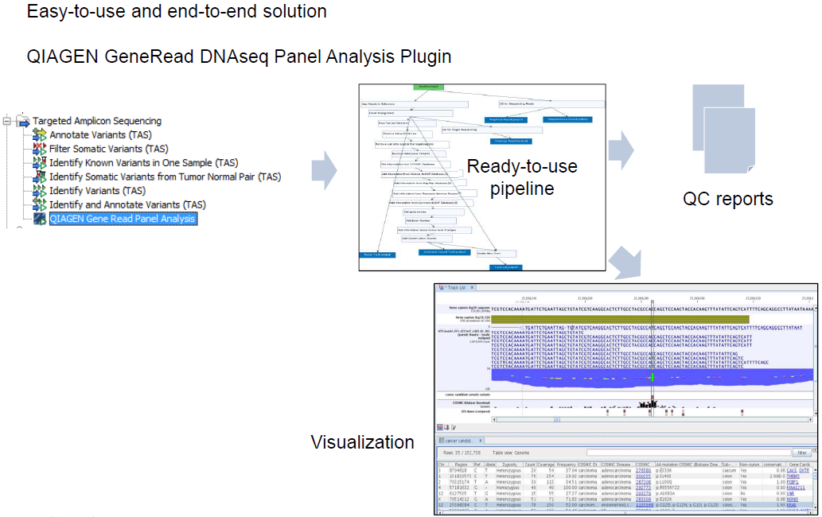
GeneRead DNAseq Panel

Slide 18
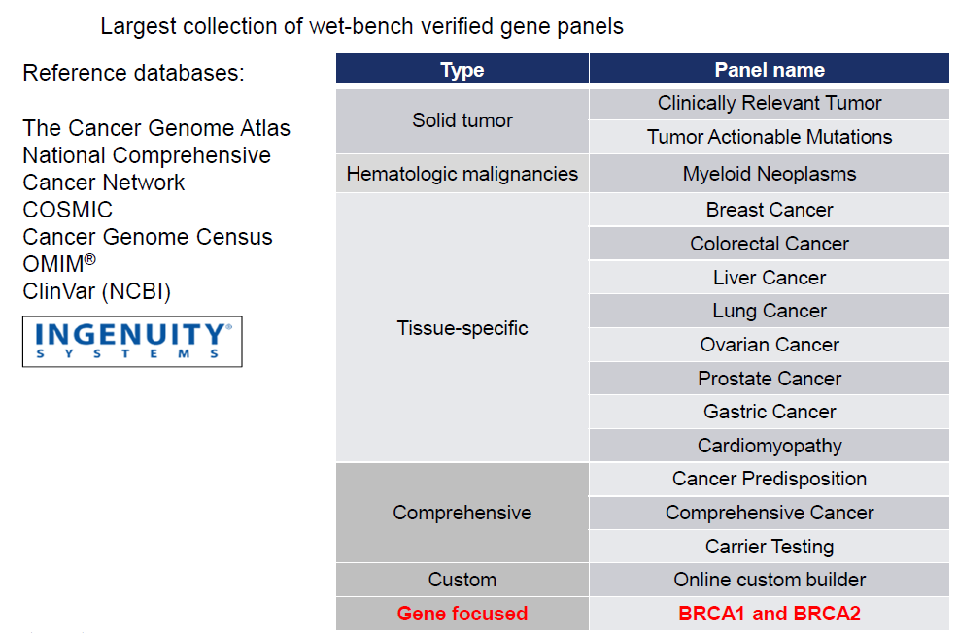
Clinically Relevant Panel

Slide 19
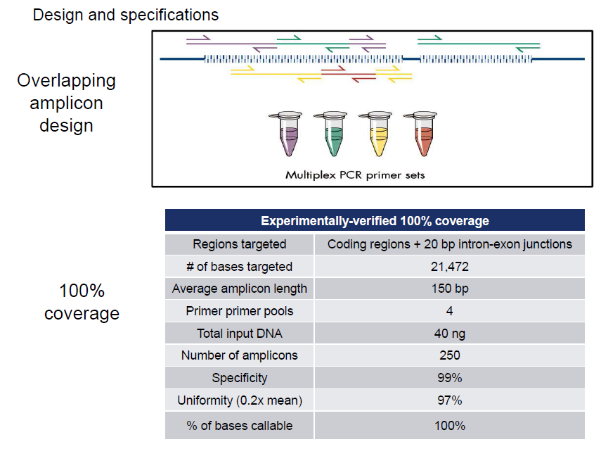
GeneRead DNAseq BRCA1 and BRCA2 Panel

Slide 20
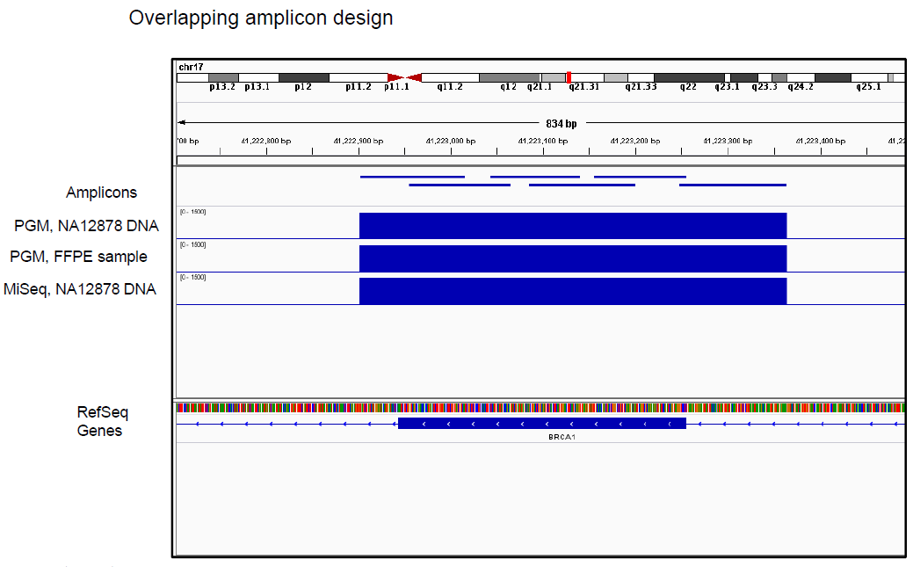
GeneRead DNAseq BRCA1 and BRCA2 Panel

Slide 21
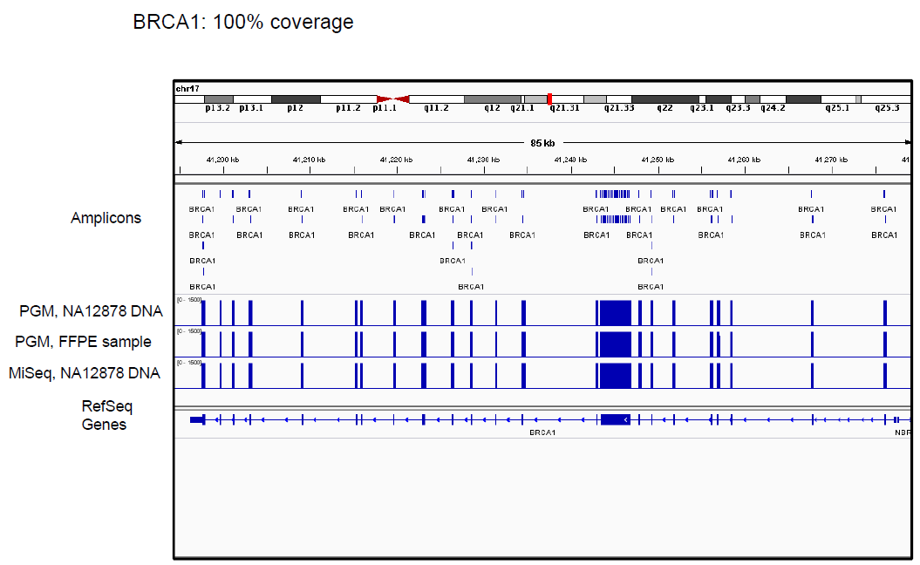
GeneRead DNAseq BRCA1 and BRCA2 Panel

Slide 22
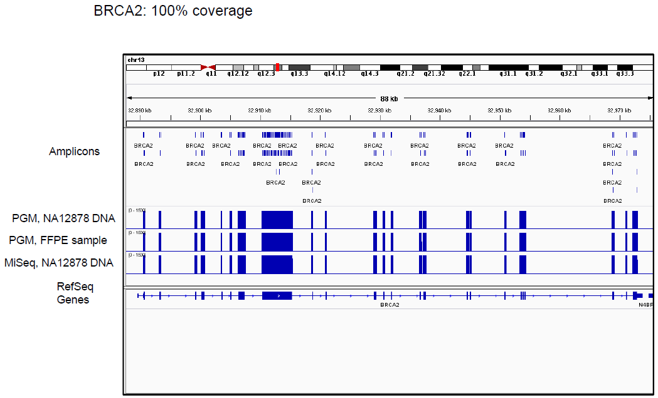
GeneRead DNAseq BRCA1 and BRCA2 Panel

Slide 23
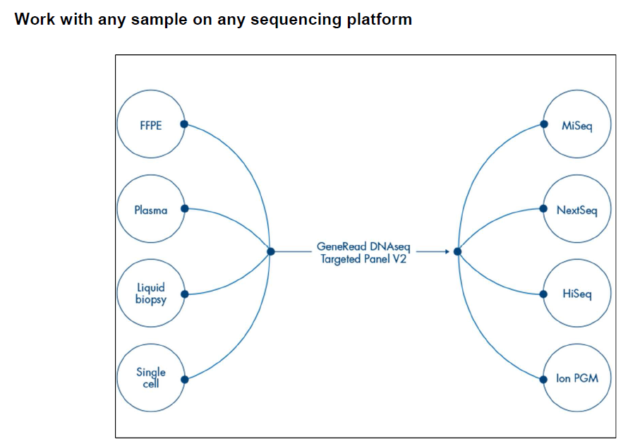
A Universal Panel
Work with any sample on any sequencing platform

Slide 24
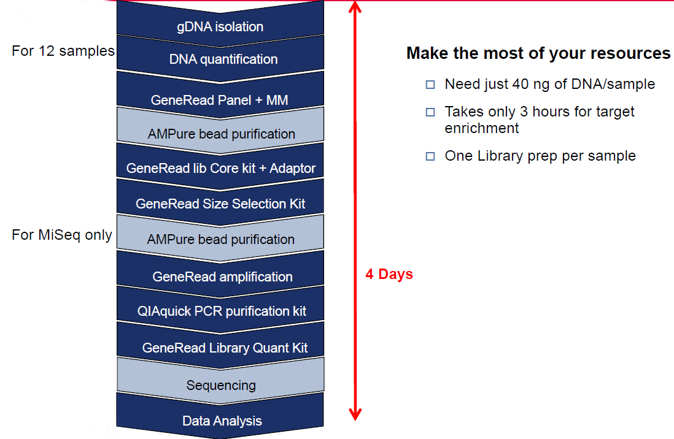
GeneRead DNAseq BRCA1 and BRCA2 Panel
Workflow

Slide 25
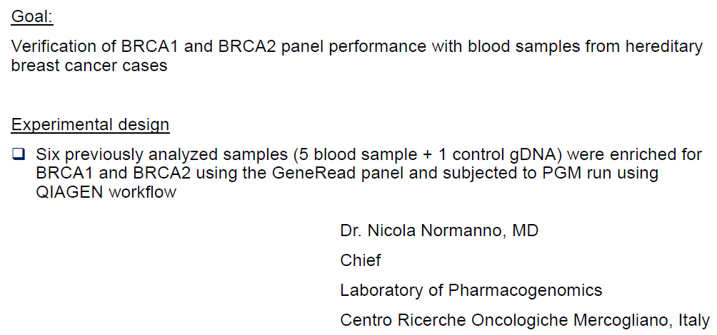
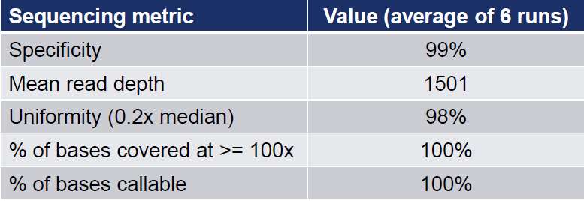
Case Study
Study 1

Slide 26
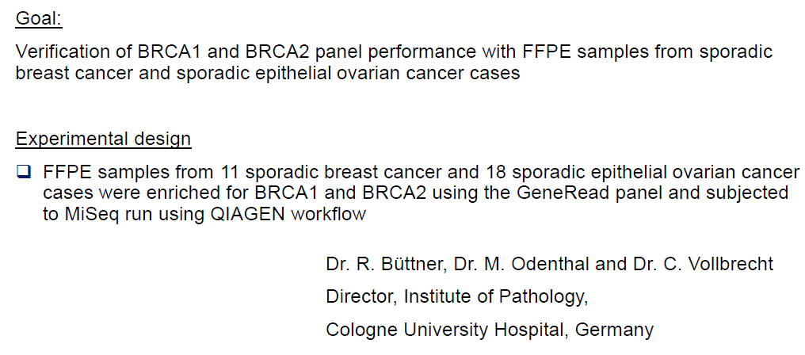
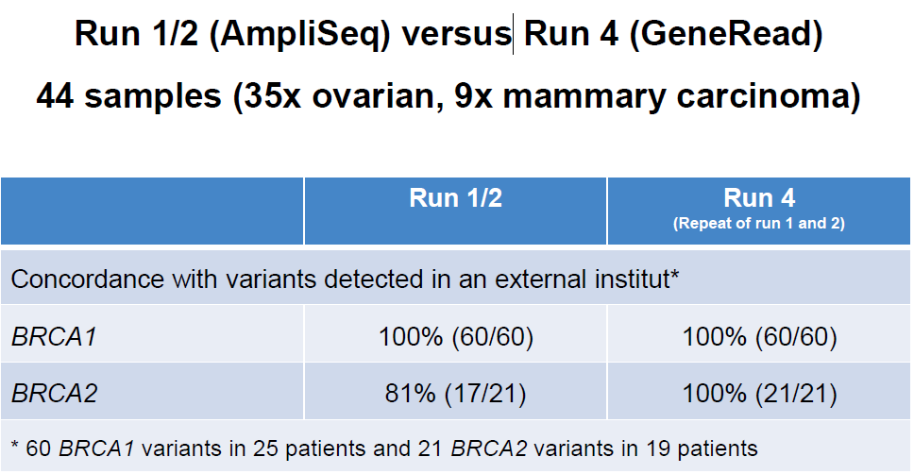
Case Study
Study 2

Slide 27
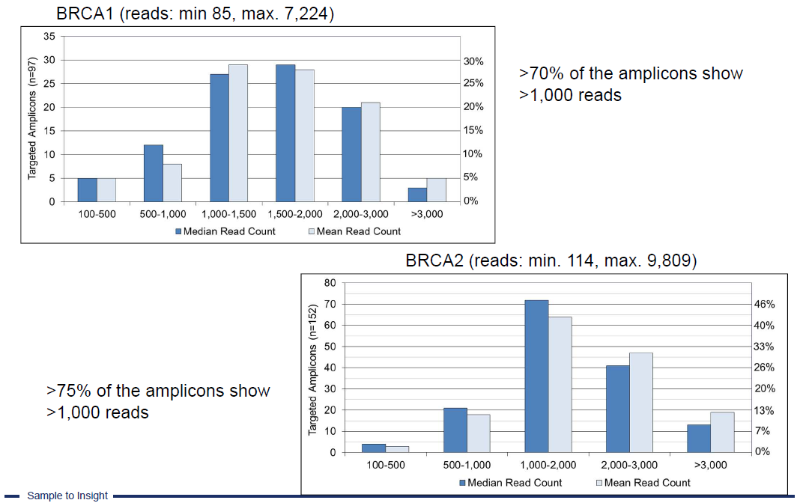
Case Study
High Uniformity

Slide 28
GeneRead DNAseq BRCA1 and BRCA2 Panel
Cost
 | Kits | Company & Cat. # | Price (RMB) | Discount (RMB)
1 | QIAamp DNA FFPE Tissue Kit (50 samples) | Qiagen-56404 | 2590 | 1683.5
2 | GeneRead DNA QuantiMIZE Assay Kit(FFPE) (400 reactions) | Qiagen-180654 | 2190 | 1423.5
3 | Human BRCA1 and BRCA2 Panel (12 samples) | Qiagen-NGHS-102X | 6260 | 4069
3 | GeneRead DNAseq Panel PCR Kit V2 (12/96 samples) | Qiagen-181940/181942 | 2080/12,769 | 1352/8,300
5 | Ion PGM Sequencer/Proton Library Prep: GeneRead DNA Library L Core Kit (12 reactions) | Qiagen-180462 | 3030 | 1969.5
 | Illumina Library Prep: GeneRead DNA Library I Core Kit (12 reactions) | Qiagen-180432 | 3030 | 1969.5
6 | GeneRead DNAseq Library Quant Assay(optional) (500 reactions) | Qiagen-180612 | 5630 | 3659.5

Slide 29
GeneRead DNAseq BRCA1 and BRCA2 Panel
Unit cost
Cost | Unit | N | Unit cost (RMB) | Subtotal
QIAamp DNA FFPE Tissue Kit | 50 samples | TBD | 34/sample | 34 X N
GeneRead DNA QuantiMIZE Array Kit(FFPE) | 400 reactions | TBD | 11/triplicate | 11 X N
Human BRCA1 and BRCA2 Panel | 12 samples | TBD | 339/sample | 339 X N
GeneRead DNAseq Panel PCR Kit V2 | 12 samples | TBD | 113/sample | 113 X N
Ion PGM Sequencer/Proton Library Prep: GeneRead DNA Library L Core Kit(alternative) | 12 reactions | TBD | 164/action | 164 X N
Illumina Library Prep: GeneRead DNA Library I Core Kit(alternative) | 12 reactions | TBD | 164/action | 164 X N
GeneRead DNAseq Library Quant Assay(optional) | 500 reactions | TBD | 22/triplicate | 22 X N
Total (Experiment for 12 samples ) |  |  |  | 683 X N

